Slide 1
Topic 4. Electronic budget

Slide 2
Electronic budget is a unified system for managing state and municipal (public) finances of the Republic of Kazakhstan using information and telecommunication technologies.

Slide 3
The Open Budgets portal ( budget.egov.kz ) is a component of the Open Government project, created to ensure transparent budgeting and the development of public control over the expenditure of budget funds.

Slide 4
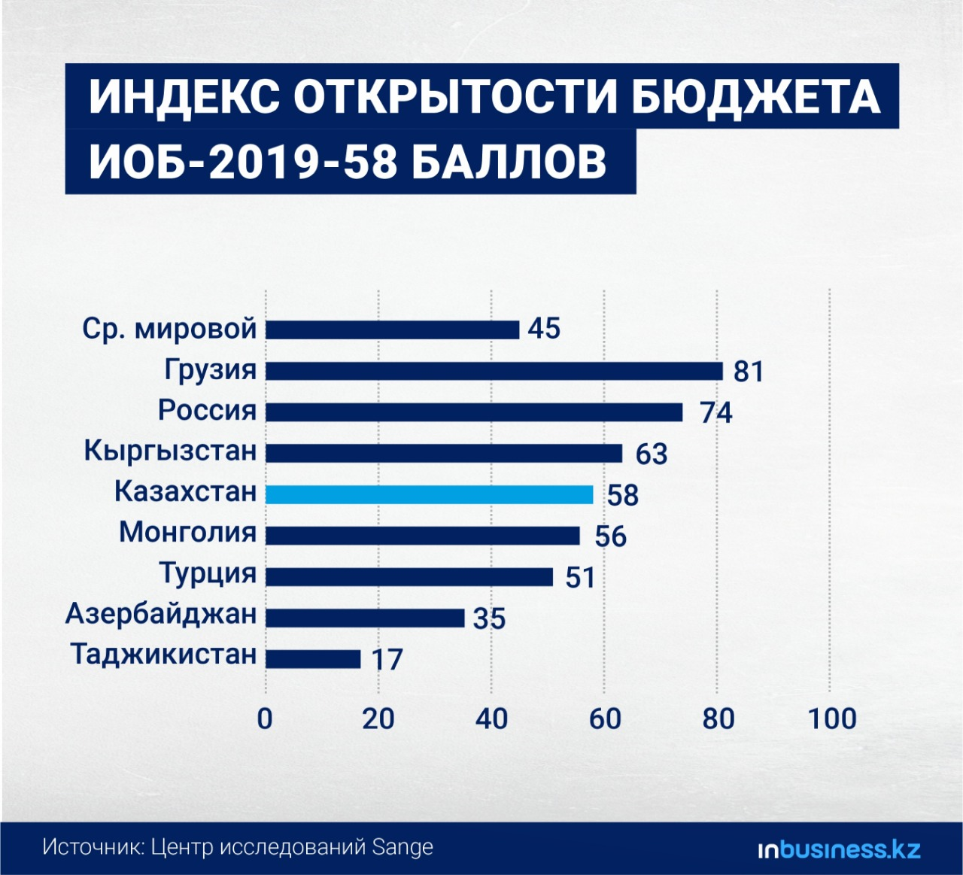

Slide 5
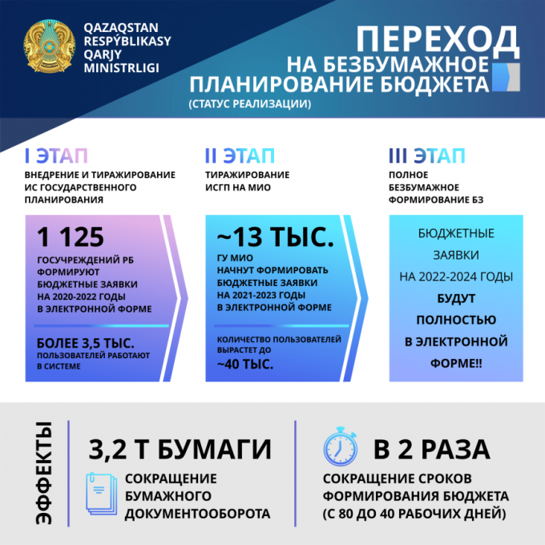

Slide 6
4. Expected effects
- reduction of the terms of budget formation by 2 times.
- Improving planning accuracy through integrations with the Public Procurement Portal.
- ensuring transparent budget consolidation.
- ensuring transparency in the calculation of budget expenditures, which will increase public confidence in the government as a whole.

Slide 7
